Slide 1

Rust-ifying Your C# Codebase
A Tale of Adventure and Transformation

Slide 2









Rust-ifying Your C# Codebase Chris Woody Woodruff

Slide 3

What is this talk?
Notes:
"Imagine you're working on a critical piece of software that must run flawlessly in a high-stakes environment, like the core system of a spacecraft or a financial trading platform. The stakes are incredibly high, and even the smallest memory leak or concurrency bug can lead to catastrophic failures. In the past, such systems were often written in languages like C or C++ for their performance, but at the cost of potentially costly and hard-to-detect bugs.
Enter Rust—a language designed to provide the performance of C++ with the safety guarantees that prevent those disastrous bugs. Companies like Microsoft, Mozilla, and Dropbox are already leveraging Rust to build reliable, high-performance systems. In fact, Microsoft is using Rust to eliminate security vulnerabilities in their critical infrastructure, and Mozilla built their high-speed, memory-safe browser engine, Servo, using Rust.
As C# developers, we already understand the importance of writing clean, maintainable, and efficient code. Transitioning to Rust can empower us to write even more robust and performant applications, ensuring the highest standards of safety and efficiency in our software. Today, we’ll explore how the skills we’ve honed in C# can be leveraged to master Rust and take advantage of its growing importance in the industry."

Slide 4
Main uses
Web Development
Cloud Development
Windows Apps
Game Dev with Unity
Web APIs
C#

Slide 5
Main Uses
Operating Systems
WebAssembly/Wasm Apps
Embedded Systems
Networking Systems
Cryptography
Web Development/Web APIs
Rust

Slide 6

Language Paradigms and Syntax
Rust-ifying Your C# Codebase

Slide 7
Comparison of paradigms
C#
Rust
C# is heavily geared towards OOP with extensive support for classes, inheritance, and interfaces.
Rust supports OOP principles through traits and structs but does not have traditional classes or inheritance.
C# relies on garbage collection, which abstracts memory management from the developer.
Rust uses an ownership model with borrowing and lifetimes, ensuring memory safety without runtime overhead.

Slide 8
Comparison of paradigms
Both languages support functional programming, but Rust’s pattern matching and immutability by default provide a more native feel to functional programming. C#’s LINQ and lambda expressions are powerful tools for functional paradigms.
Rust’s concurrency model, built on the ownership system, ensures compile-time guarantees against data races, making it safer than C#’s traditional threading model. Both languages support async programming with similar syntax.

Slide 9
Syntax comparison with code examples
C#
Rust
int number = 10;
string message = "Hello, World!";
bool isActive = true;
let number: i32 = 10;
let message: &str = "Hello, World!";
let is_active: bool = true;
Variable Declarations

Slide 10
Syntax comparison with code examples
C#
Rust
int Add(int a, int b) {
return a + b;
}
string Greet(string name) {
return $"Hello, {name}!";
}
fn add(a: i32, b: i32) -> i32 {
a + b
}
fn greet(name: &str) -> String {
format!("Hello, {}!", name)
}
Functions

Slide 11
Syntax comparison with code examples
C#
Rust
int number = 10;
if (number > 5) {
Console.WriteLine("Number is greater than 5");
} else {
Console.WriteLine("Number is 5 or less");
}
let number = 10;
if number > 5 {
println!("Number is greater than 5");
} else {
println!("Number is 5 or less");
}
Conditionals

Slide 12
Syntax comparison with code examples
C#
Rust
for (int i = 0; i < 5; i++) {
Console.WriteLine($"Iteration {i}");
}
int count = 0;
while (count < 5) {
Console.WriteLine($"Count {count}");
count++;
}
for i in 0..5 {
println!("Iteration {}", i);
}
let mut count = 0;
while count < 5 {
println!("Count {}", count);
count += 1;
}
Loops

Slide 13
Syntax comparison with code examples
C#
Rust
try {
int result = 10 / 0;
} catch (DivideByZeroException e) {
Console.WriteLine("Cannot divide by zero");
}
fn divide(a: i32, b: i32) -> Result<i32, &'static str> {
if b == 0 {
Err("Cannot divide by zero")
} else {
Ok(a / b)
}
}
Basic Error Handling

Slide 14
Differences in OOP Approaches Between C# and Rust
C#
Rust
Classes: C# uses classes to define blueprints for objects. Classes encapsulate data (fields) and behavior (methods) and support inheritance and polymorphism.
Inheritance: C# supports single inheritance through classes and multiple inheritance through interfaces.
Interfaces: Interfaces define a contract that classes can implement, allowing for polymorphism.
Structs: Rust uses structs to define data structures. Structs are used to encapsulate data but do not have associated methods.
Traits: Traits in Rust define shared behavior (methods) that types can implement. Traits are similar to interfaces in C# but are more powerful and flexible.
No Inheritance: Rust does not support traditional inheritance. Instead, it uses trait implementations to achieve polymorphism.

Slide 15
DIFFERENCES IN OOP APPROACHES BETWEEN C# AND RUST
public interface IShape {
double Area();
}
public class Circle : IShape {
public double Radius { get; set; }
public Circle(double radius) {
Radius = radius;
}
public double Area() {
return Math.PI * Radius * Radius;
}
}
C#

Slide 16
DIFFERENCES IN OOP APPROACHES BETWEEN C# AND RUST
trait Shape {
fn area(&self) -> f64;
}
struct Circle {
radius: f64,
}
impl Circle {
fn new(radius: f64) -> Self {
Circle { radius }
}
}
impl Shape for Circle {
fn area(&self) -> f64 {
std::f64::consts::PI * self.radius * self.radius
}
}
Rust

Slide 17

Memory Management
Rust-ifying Your C# Codebase

Slide 18
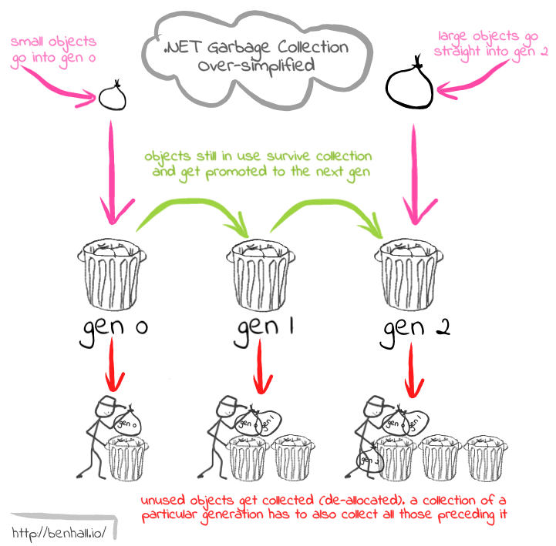
Garbage collection in C#
C#

Slide 19
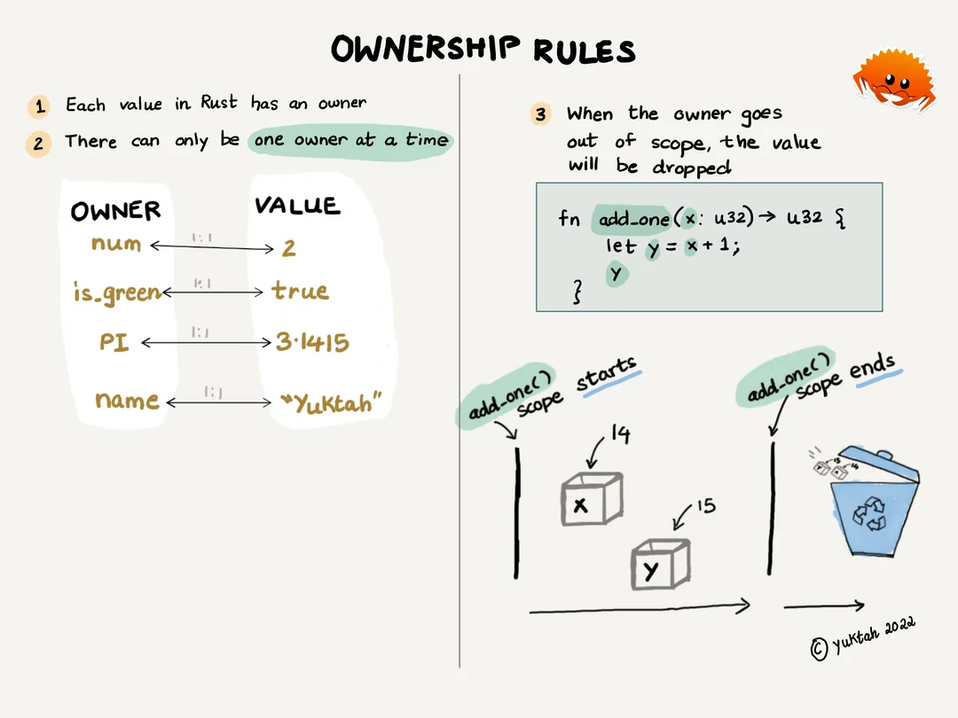
Rust’s ownership and borrowing
Rust

Slide 20
Rust’s ownership and borrowing
Basic Ownership
fn main() {
let s1 = String::from("Hello"); // s1 owns the String
let s2 = s1; // Ownership is transferred to s2; s1 is no longer valid
// println!("{}", s1); // This line would cause a compile-time error because s1 is no longer valid
println!("{}", s2); // s2 owns the String now
}

Slide 21
Rust’s ownership and borrowing
Immutable Borrowing
fn main() {
let s1 = String::from("Hello");
let len = calculate_length(&s1); // &s1 is an immutable reference to s1
println!("The length of '{}' is {}.", s1, len);
}
fn calculate_length(s: &String) -> usize {
s.len() // We can use s without taking ownership
}

Slide 22
Rust’s ownership and borrowing
Mutable Borrowing
fn main() {
let mut s = String::from("Hello");
change(&mut s); // &mut s is a mutable reference to s
println!("{}", s); // s has been modified
}
fn change(some_string: &mut String) {
some_string.push_str(", world!"); // We can modify the String through the mutable reference
}

Slide 23
Rust’s ownership and borrowing
Transferring Ownership to Functions
fn main() {
let s = String::from("Hello");
takes_ownership(s); // s is moved into the function and is no longer valid here
// println!("{}", s); // This line would cause a compile-time error because s is no longer valid
}
fn takes_ownership(some_string: String) {
println!("{}", some_string);
} // some_string goes out of scope and is dropped here

Slide 24
Rust’s ownership and borrowing
Returning Ownership from Functions

Slide 25
fn main() {
let s1 = gives_ownership(); // gives_ownership moves its return value into s1
let s2 = String::from("Hello");
let s3 = takes_and_gives_back(s2); // s2 is moved into takes_and_gives_back, which also returns ownership to s3
// println!("{}", s2); // compile-time error because s2 is no longer valid
println!("{}", s3); // s3 owns the String now
}
fn gives_ownership() -> String {
let some_string = String::from("Hello");
some_string // some_string is returned and moves out to the caller
}
fn takes_and_gives_back(a_string: String) -> String {
a_string // a_string is returned and moves out to the caller
}

Slide 26
Rust’s ownership and borrowing
fn main() {
let string1 = String::from("long string is long");
let result;
{
let string2 = String::from("xyz");
result = longest(string1.as_str(), string2.as_str());
// string2 goes out of scope here, but result's lifetime is tied to the shorter of string1 and string2
}
println!("The longest string is {}", result);
}
fn longest<'a>(x: &'a str, y: &'a str) -> &'a str {
if x.len() > y.len() {
x
} else {
y
}
}
Lifetimes in Function Signatures

Slide 27

Concurrency
Rust-ifying Your C# Codebase

Slide 28
Asynchronous programming in C#
class Program
{
static async Task Main(string[] args)
{
Console.WriteLine("Starting async method...");
string result = await FetchDataAsync("https://async.com/todos/1");
Console.WriteLine("Data fetched:");
Console.WriteLine(result);
}
static async Task<string> FetchDataAsync(string url)
{
using HttpClient client = new HttpClient();
HttpResponseMessage response = await client.GetAsync(url);
response.EnsureSuccessStatusCode();
string responseData = await response.Content.ReadAsStringAsync();
return responseData;
}
}

Slide 29
use reqwest::Error;
async fn main() -> Result<(), Error> {
println!("Starting async method...");
let result = fetch_data_async("https://async.com/todos/1").await?;
println!("Data fetched:");
println!("{}", result);
Ok(())
}
async fn fetch_data_async(url: &str) -> Result<String, Error> {
let response = reqwest::get(url).await?;
// This ensures the response was successful
response.error_for_status_ref()?;
let response_text = response.text().await?;
Ok(response_text)
}
Asynchronous programming in Rust

Slide 30
Safe concurrency in Rust
Ownership: Each value in Rust has a single owner, and when the owner goes out of scope, the value is dropped. This ensures that memory is safely managed without manual intervention.
Borrowing: Rust allows references to values to be borrowed either immutably (&T) or mutably (&mut T). Immutably borrowed references can be shared, but mutable references are exclusive.
Ownership and Borrowing

Slide 31
Safe concurrency in Rust
Exclusive Access: Rust’s borrowing rules ensure that mutable references are exclusive, preventing data races. If a value is mutably borrowed, no other references to that value (mutable or immutable) can exist, ensuring that only one thread can modify the value at a time.
Mutual Exclusion

Slide 32
Safe concurrency in Rust
Send and Sync Traits: Rust uses two special traits to manage concurrency:
Send: Indicates that ownership of the type can be transferred to another thread.
Sync: Indicates that it is safe for the type to be referenced from multiple threads.
By default, types in Rust are neither Send nor Sync, ensuring that only types explicitly marked as safe can be shared or transferred across threads.
Thread Safety

Slide 33
Safe concurrency in Rust
Compile-Time Guarantees: Rust’s compiler enforces rules to ensure that data races and other concurrency issues are caught at compile time, rather than at runtime. This makes concurrent programming safer and less error-prone.
Concurrency Primitives: Rust’s standard library provides concurrency primitives such as threads, channels, and locks, which are designed to work seamlessly with Rust’s ownership and type system to ensure safe concurrent execution.
Fearless Concurrency

Slide 34
SAFE CONCURRENCY IN RUST
use std::thread;
use std::sync::mpsc;
fn main() {
let (tx, rx) = mpsc::channel();
let handle = thread::spawn(move || {
let val = String::from("Hello");
tx.send(val).unwrap();
// val is moved here and can no longer be used
});
let received = rx.recv().unwrap();
println!("Received: {}", received);
handle.join().unwrap();
}
Notes:
Explanation
Channel Creation: mpsc::channel creates a transmitter (tx) and receiver (rx) for sending messages between threads.
Thread Spawning: thread::spawn creates a new thread. The transmitter tx is moved into the closure, ensuring that it is used safely within the new thread.
Message Sending: The thread sends a message through the channel using tx.send(val).unwrap(). The ownership of val is transferred to the channel, ensuring no concurrent access issues.
Message Receiving: The main thread receives the message using rx.recv().unwrap(), ensuring safe communication between threads.
Thread Joining: handle.join().unwrap() ensures that the main thread waits for the spawned thread to finish before exiting, preventing any potential race conditions.
Rust’s design enforces strict compile-time checks to ensure that all concurrent code adheres to safe practices, making it a powerful tool for writing safe and efficient concurrent programs.

Slide 35
Benchmarking

Slide 36
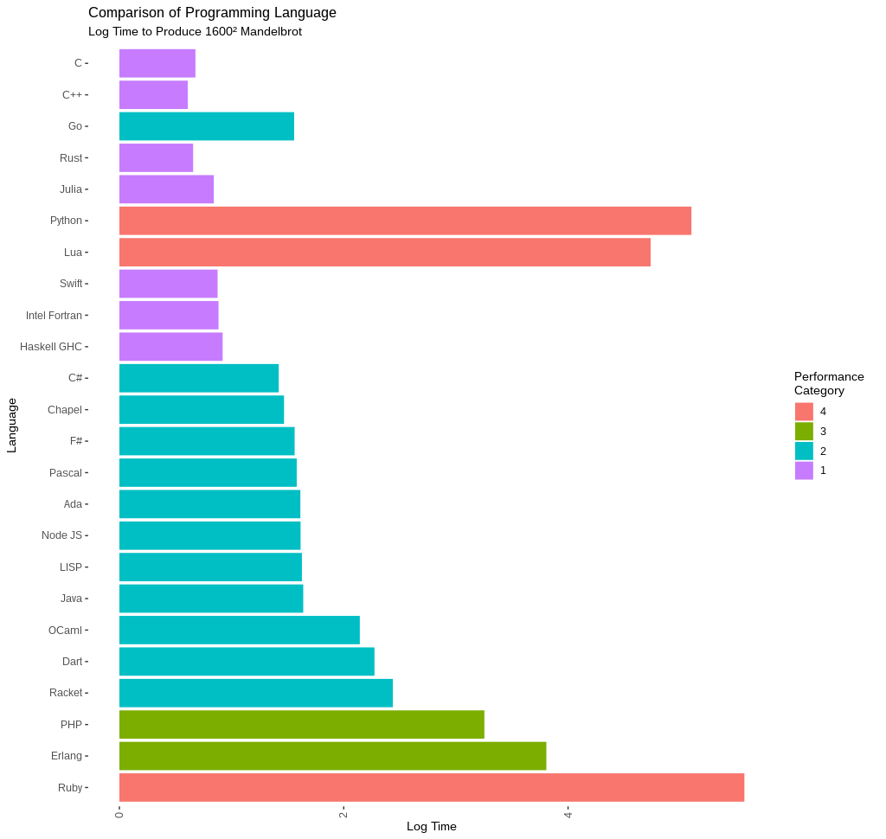
Speed

Slide 37
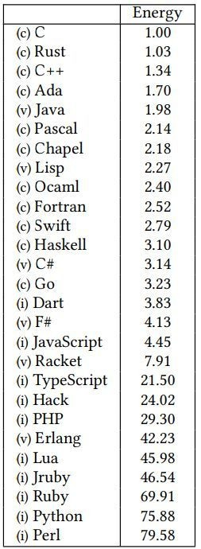
Power Consumption

Slide 38

Ecosystem and Tooling
Rust-ifying Your C# Codebase

Slide 39



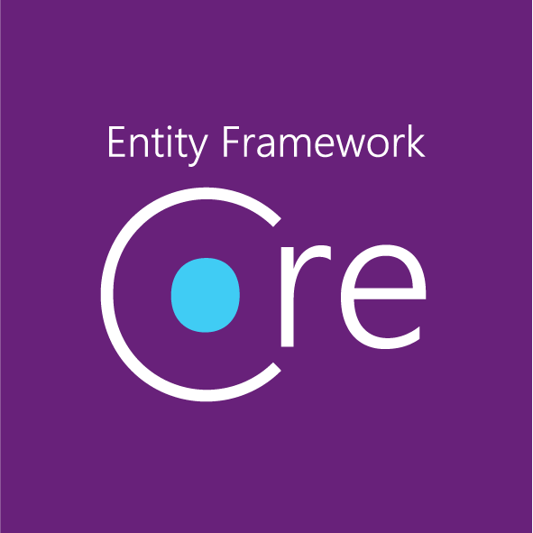






Overview of .NET ecosystem

Slide 40










Introduction to Rust’s ecosystem and tools
Crates
Rustup
Clippy
Rustfmt
Actix
Rocket
Warp
Notes:
Rust
Crates
Rustup
Clippy
Rustfmt
Actix Web
Rocket
Warp
Poem

Slide 41

Learning Path and Practical Tips
Rust-ifying Your C# Codebase

Slide 42
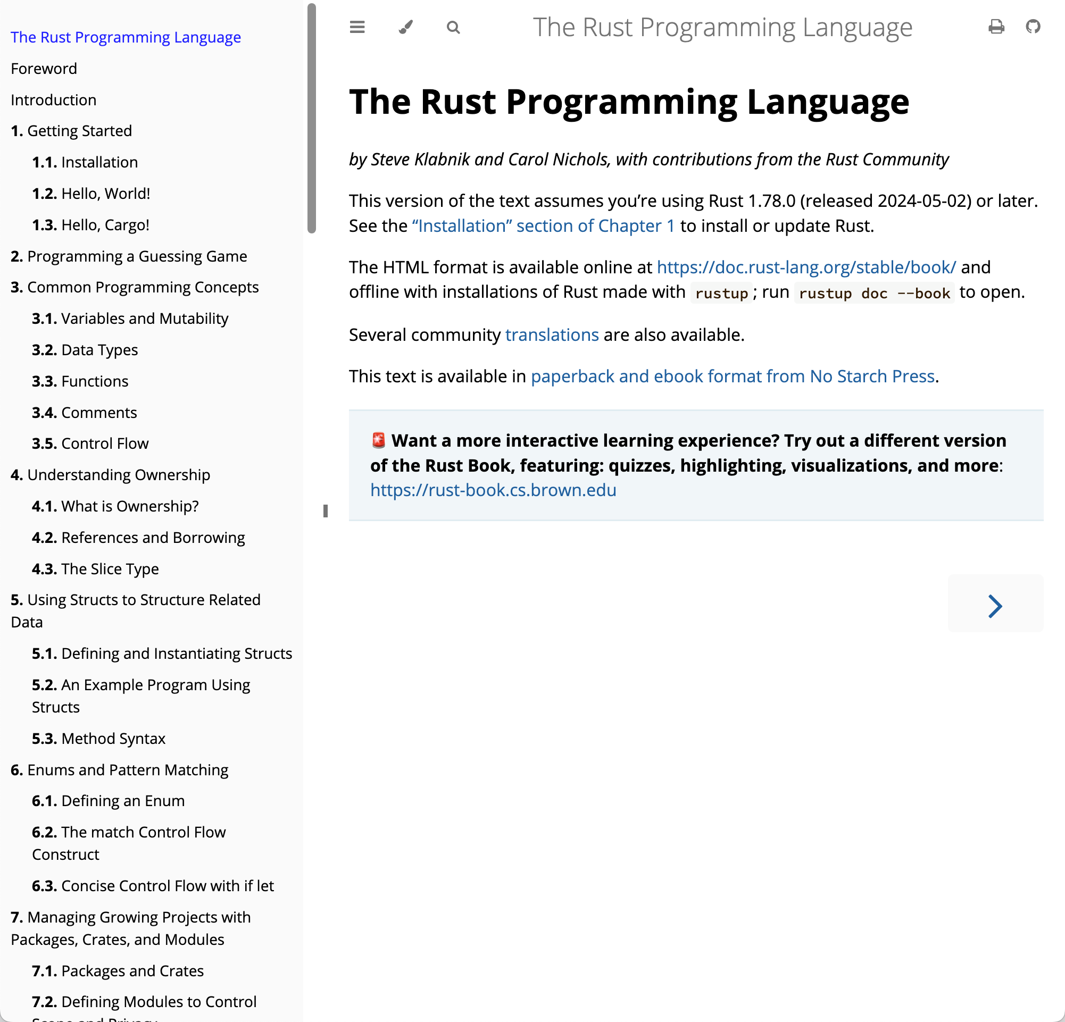
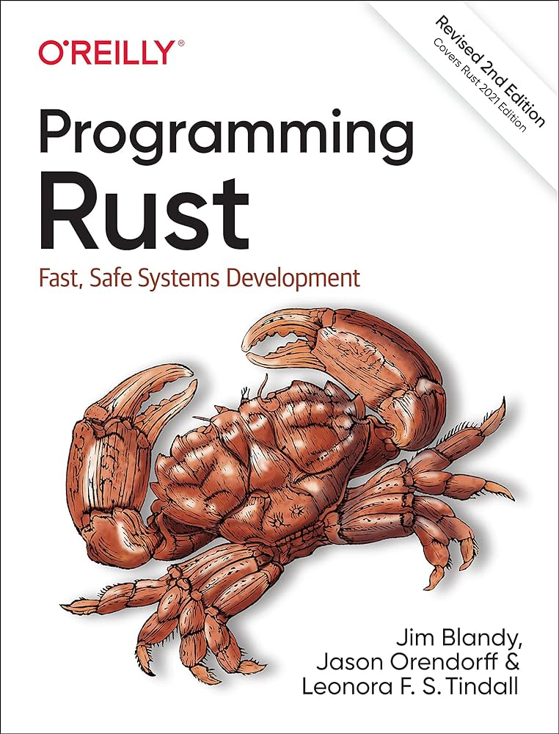


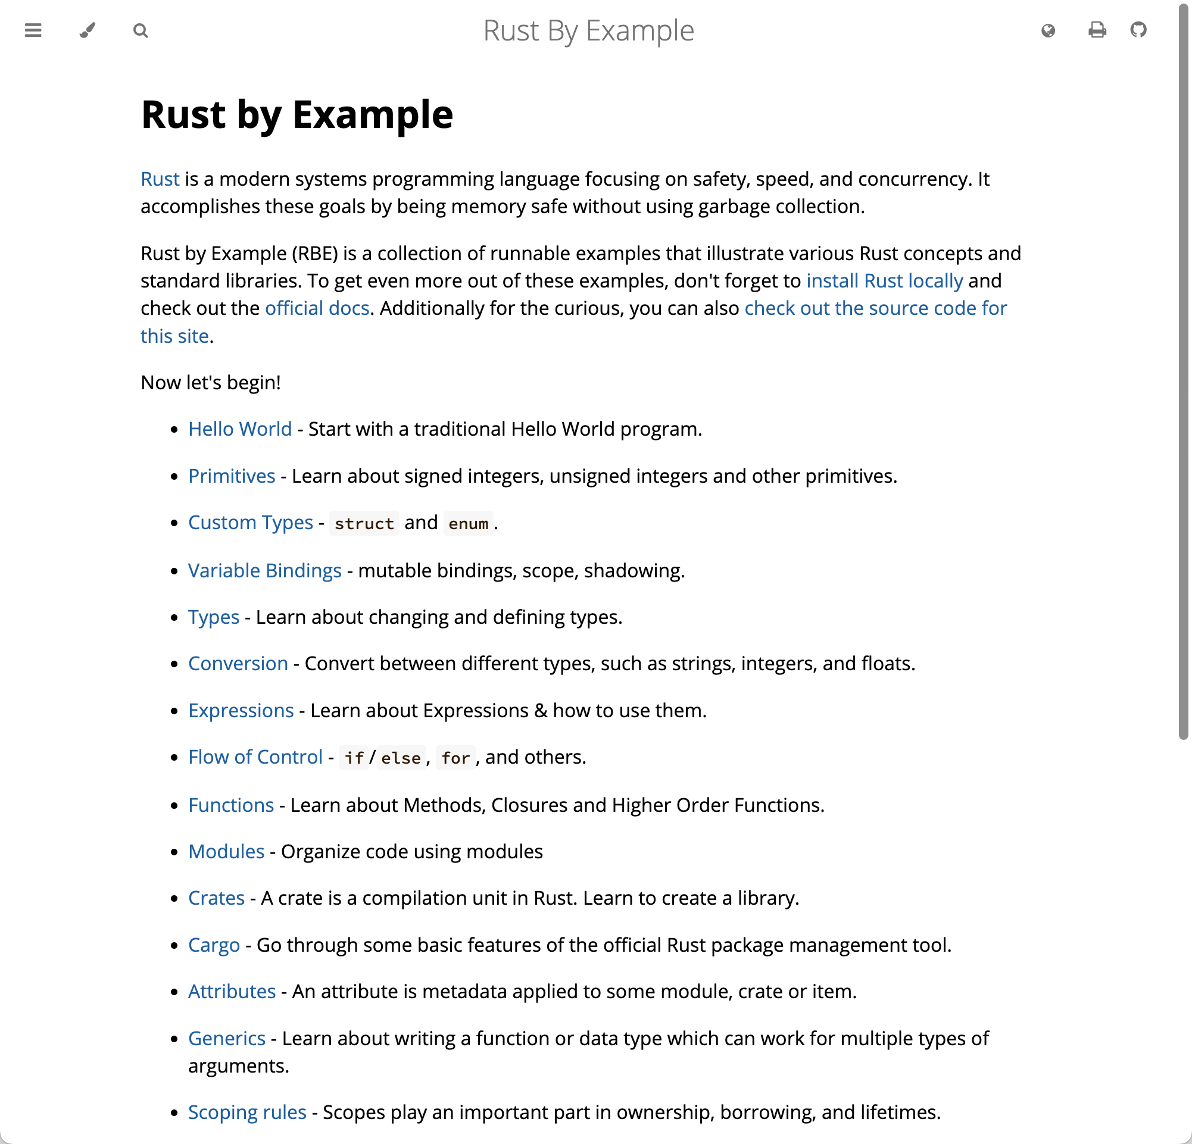
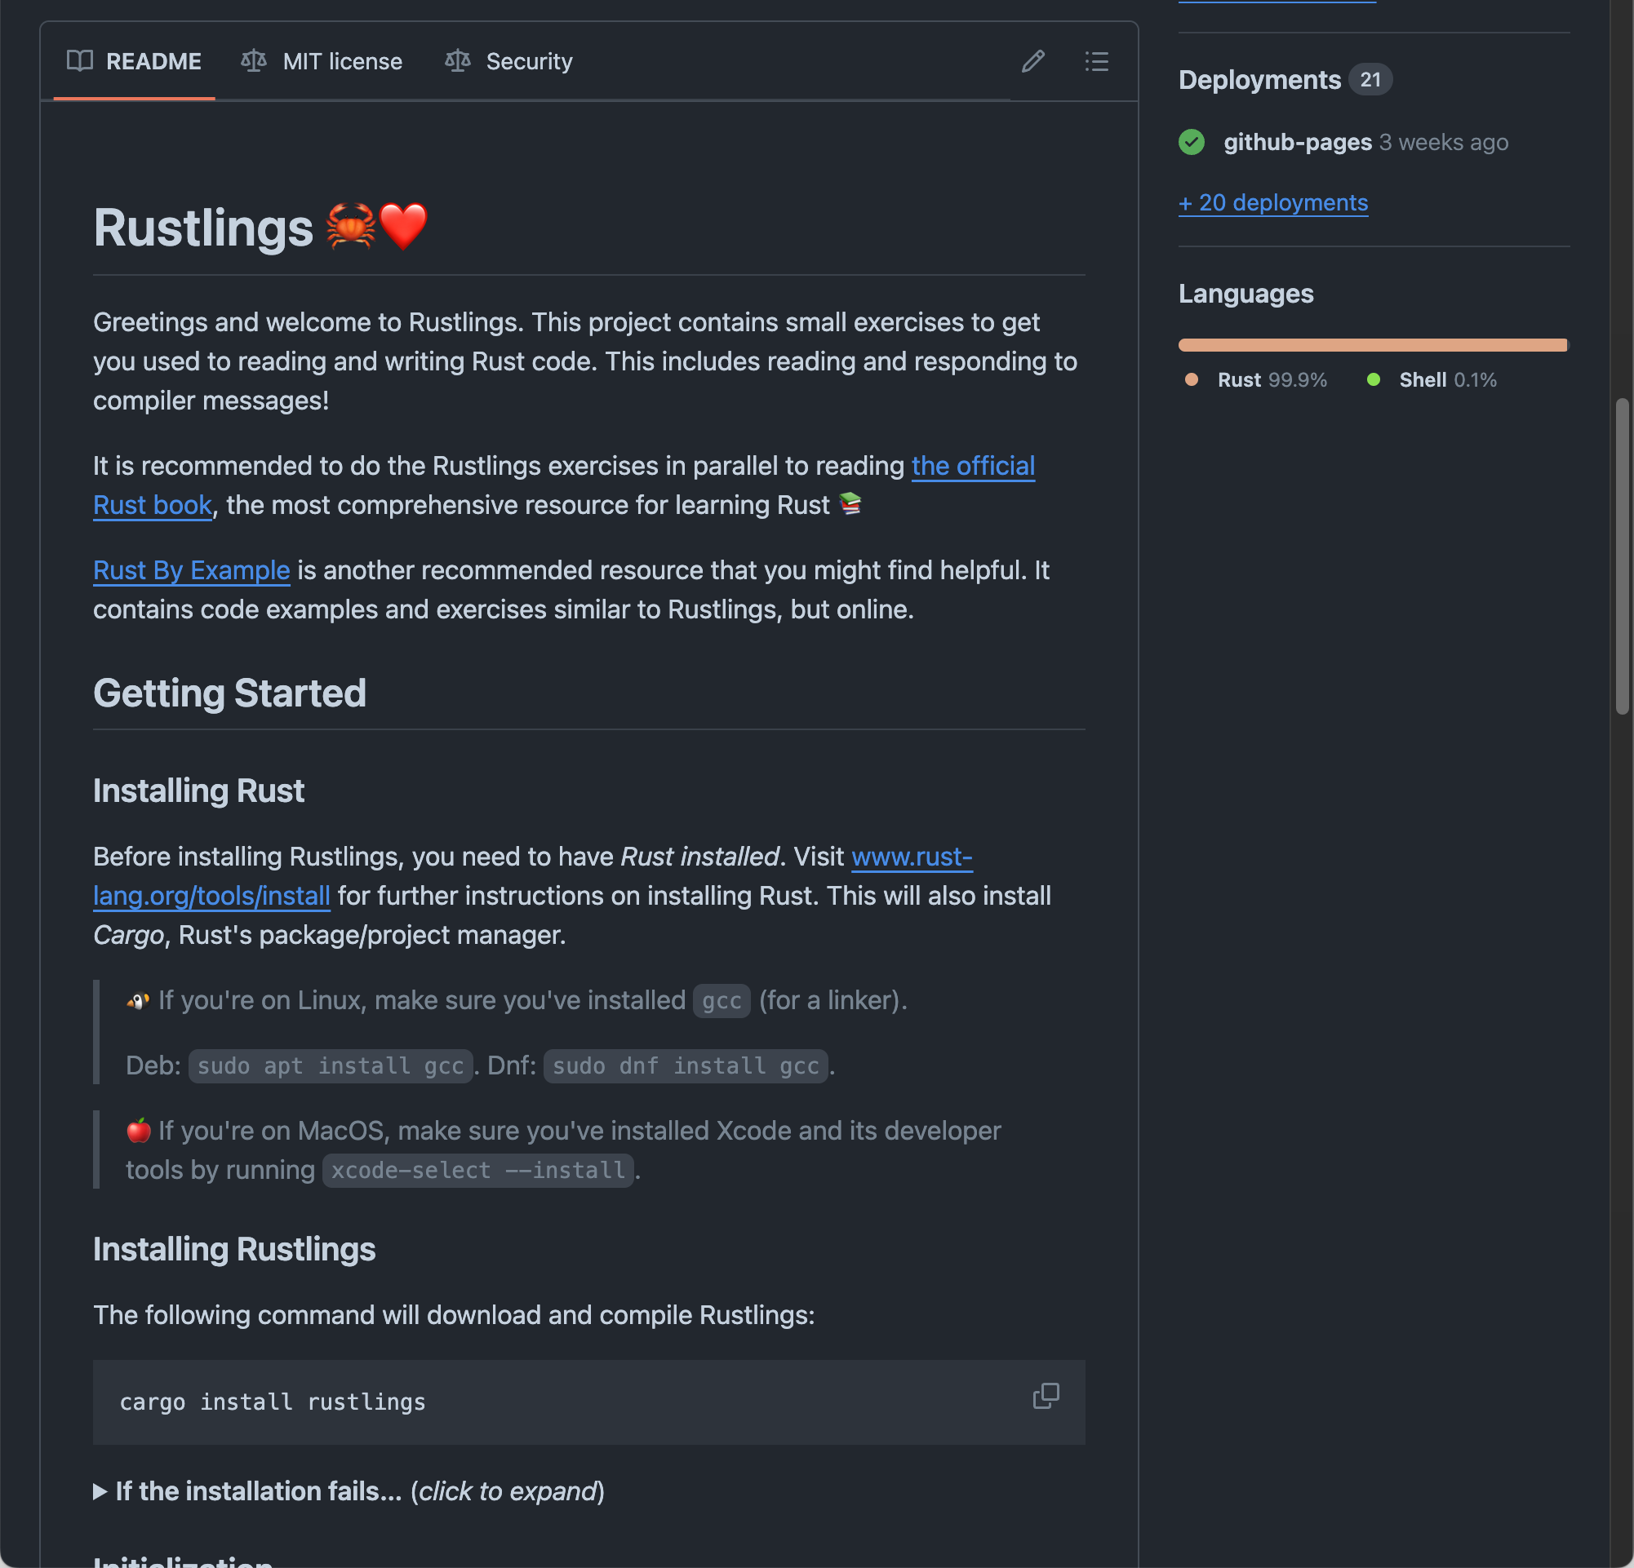
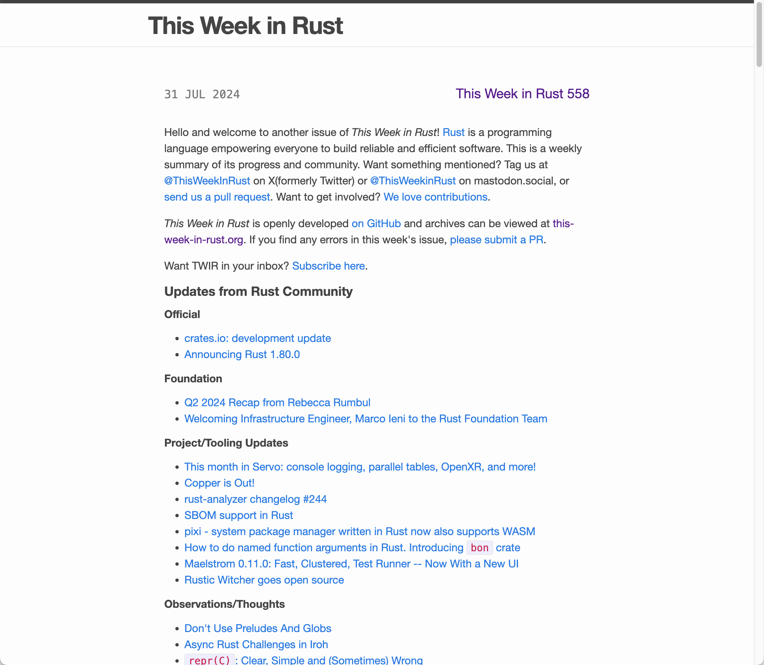

Practical tips for learning Rust

Slide 43
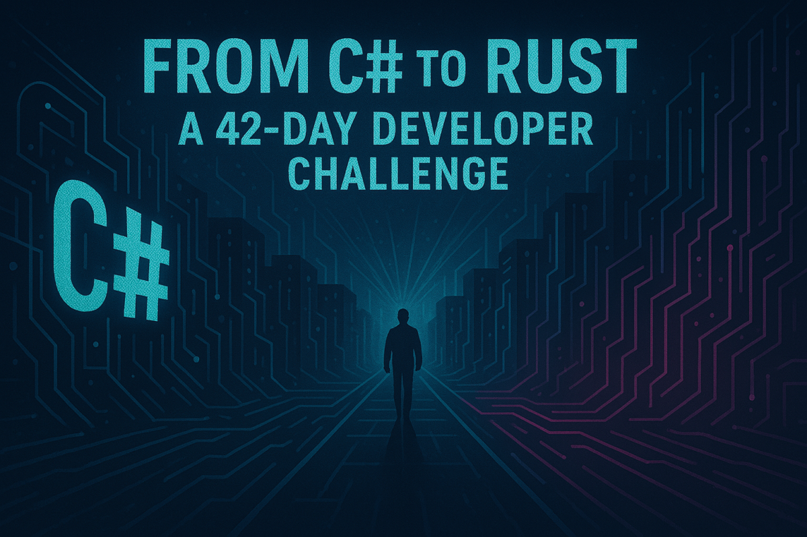


Slide 44



Open for questions

Slide 45


My Contact Info and Podcast and Book
https://csharp-networking.com
cwoodruff@live.com
https://woodruff.dev
https://github.com/cwoodruff
https://bluesky.com/@woodruff.dev
https://mastodon.social/@cwoodruff
https://www.breakpoint.show

Slide 46

GitHub Repo has the slides
https://github.com/cwoodruff/rustifying-your-csharp-codebase

